Slide 1

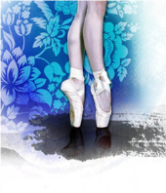
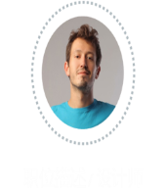
2023年深圳二模读后续写
拳击梦
Zoe

Slide 2

目录
CONTENTS
01
题目评析、故事线
02
下水作文
03
竞赛类、成长类语料
04
语言表述积累

Slide 3
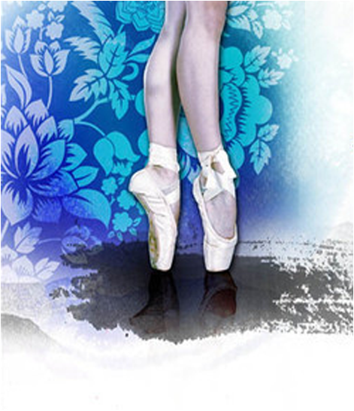
01
题目评析、故事线

Slide 4
Ballet was a way of life in Kelly’s family.Her elder sister Serena was now dancing at a top college. Though Kelly’s mom always wanted her to follow in her sisters footsteps and Kelly herself was good at ballet, her love for ballet had faded years before and she was eager for a new challenge. One day at school, as Kelly left the dance studio she walked past the gym,fascinated by boxers(拳击手)training inside the boxing ring. She was deeply impressed by how hard they hit and how fast they moved. In fact shed long been attracted to boxing.
She pulled a piece of paper from her backpack.On the familiar Oakwood High School Club Sign-up Sheet was the phrase:BOXING CLUB TRYOUT(选拔).That was what Kelly really wanted to do.She knew her mom had high expectations for her when it came to ballet. Tired of trying to keep up with her sister, Kelly was ready to carve her own path.
The next day, she gathered her courage and told Serena about her new passion. At first Serena didn’t understand and thought she was just joking.But when she saw Kelly was serious. she replied,“You know Mom wants you to be a ballet dancer,right?Besides, boxing is only for boys, and you’re so good at ballet.Lean into your strength, Kelly."
“But this is where I want to put my strength,”Kelly insisted,“and what exactly does 'only for boysmean, anyway? Boxing is a sport for everyone!”
Gradually, touched by her determination and passionSerena began to understand and support her. Kelly could feel it.Her sister was going to respect her decision no matter what. But that was nothing compared to the preparations for the tryout,where she was required to show her footwork and punching(击打)abilities with other candidates.Boxing didn’t come natural to Kelly, but she had made up her mind to stick with her choice.
Then Kelly began her training for the tryout, keeping it a secret from her mom.
The following Monday, results of the boxing tryout were posted.

Slide 5

故事线
主要讲述了主人公Kelly不想按照母亲为她打造的芭蕾之路，不想跟姐姐Serena一样上芭蕾大学，她想练习拳击。在得到姐姐的支持后，Kelly瞒着妈妈，偷偷练习拳击，准备参加拳击俱乐部选拔。
梗概
主题
人与自我：竞技类
视角
第三人称视角

Slide 6
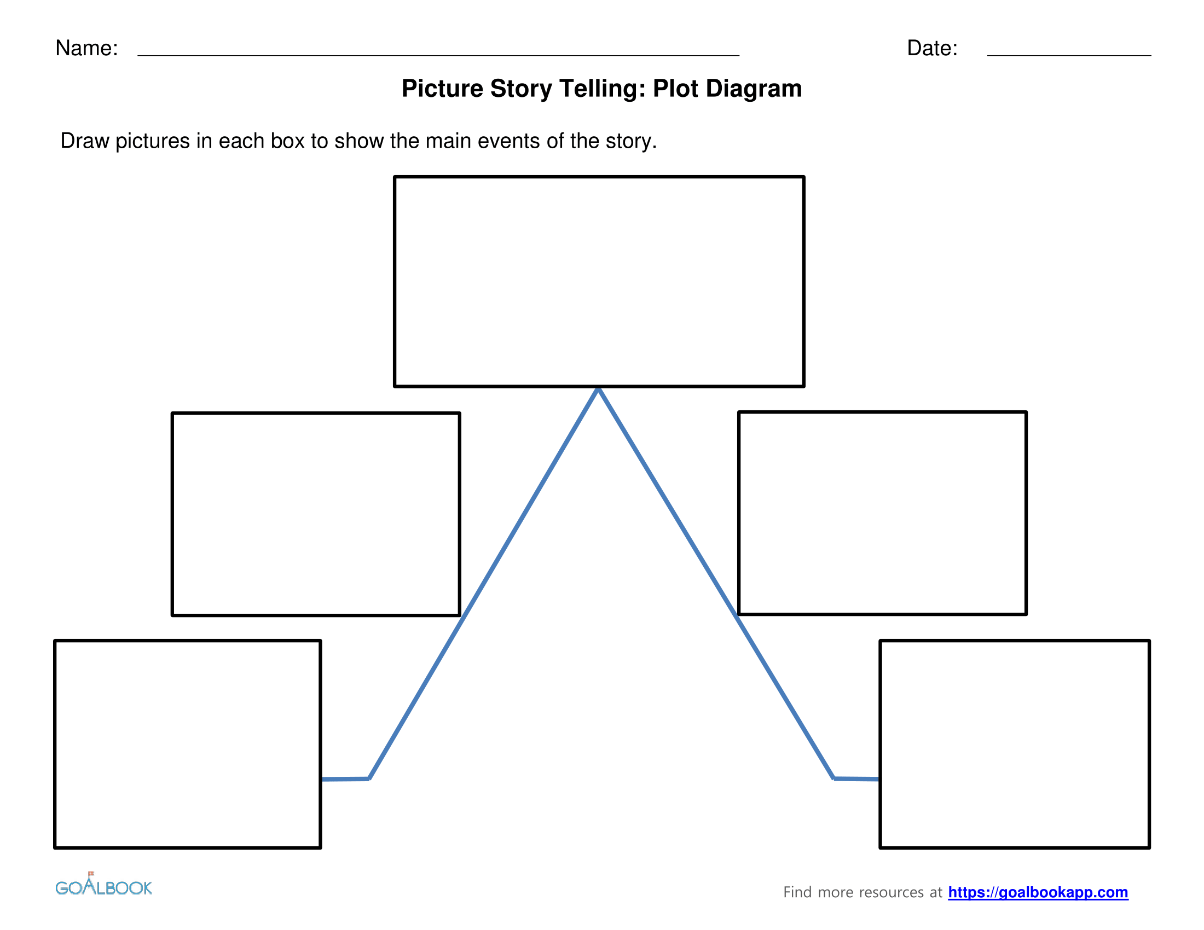
climax
故事线
Kelly told Serana that she
could stick with her choice
of boxing
One day she saw
BOXING CLUB
TRYOUT
She kept practicing
for the boxing
tryout.
reversal
trigger
Kelly was good at ballet,
but her love for ballet
had faded away.
the resultsof the
tryout were posted
resolution
stasis

Slide 7
首句句子中的新事物（对比前文）助力续写情节构建
Then Kelly began her training for the tryout, keeping it a secret from her mom.
1. Her training refers to boxing training, that is something new compared to the old life.
So how did the training go? Would it be enjoyable at the beginning for practising a new sport?
2. Keeping it a secret means that not letting her mom get to know that she didn’t go to the ballet training.
How could it work out to hide from her mom?
Would her sister help in this process?

Slide 8
首句句子中的新事物（对比前文）助力续写情节构建
The following Monday, results of the boxing tryout were posted.
Results of the boxing tryout mean whether Kelly would be selected into the club or not.
What was the result for Kelly? Think.
If she was not qualified, there would be no problem left.
If she was selected, then what was the problem?
How to break the news to her mom?

Slide 9
解题作答
主题：学会遵从内心的抉择。
情节安排续写第一段：如何训练，如何瞒过妈妈。
情节安排续写第二段：
交代结果，如何向妈妈说出心之所向，获得支持。

Slide 10
02
下水作文

Slide 11
邹老师下水作文1
Then Kelly began her training for the tryout, keeping it a secret from her mom. Everyday afternoon when she was off from school, she directly strode to the boxing ring to learn the basic footing, different striking from different angles. It was an exhausted workout, especially for a beginner like her. Years of ballet practice made her both arms and fists too supple to change them into powful one. But she could endure all the hardship because that was what she chose. What she could not bear was when she came back home and lied to her mom about her day, making up all the ballet thing. These new normal came to an end when the final day of selection was scheduled to a Friday.
The following Monday, results of the boxing tryout were posted. Kelly stood on the tiptoes to reach the top the list. Her eyeballs moved rapidly in search of her name. The first column, none. The second column, neither. Her heart pounded fiecely. The third column was her last hope. The last but two was hers -- Kelly！She made her entrance to the club. She rushed home to break the sweatbitter news to her mom. With her sister Serana backing her firmly, her mom finally agreed that Kelly could follow her passion to boxing.

Slide 12
邹老师下水作文2
Then Kelly began her training for the tryout, keeping it a secret from her mom. It felt so odd when the training spot was filled with boys and she as an only female there was toiled for the musculinary fist striking and standing with typical boxing posture. However, it didn’t affect her determination at all. Day by day she was building up her strength. When the big day for tryout came, she knew she was ready for it. Only one thing troubled her determined mind, which was how to tell the truth to her mom.
The following Monday, results of the boxing tryout were posted. Kelly’s name was printed on the top of the list. She smiled to herself inwardly. Hard work paid off. The only problem left was to convince her mom that boxing was her real passion and she wished to chase what she loved to do. Serena promised to help her when she broke the news. At first mom was startled and furious that Kelly cheated on her. However, gradually she sensed that it was time to let her child follow her heart to do something she persisted. She started to appreciate that her daughter actually outgrew her wit.

Slide 13
03
竞赛类语料

Slide 14
啦啦队训练
1）I helped three of the new girls and worked with them on our basic practice of cheerleaders.（宁波市2022学年第一学期高考与选考模拟考试:啦啦队训练动作） I showcased the new girls stunts like how to tumble strong and powerful. 我展示了新女孩的特技，比如如何强壮有力地翻腾。 I demonstrated them the classic triangle formation, ripple cheers, and how to end a perfect routine. 我向他们展示了经典的三角队形、涟漪式的欢呼声，以及如何结束完美的一套动作。

Slide 15
赛马比赛
1）My turn finally came.(2021.12八省联考T8 赛马比赛前不安） Spirals of self-doubt accumulated into my heart in order to overwhelm me. 自我怀疑的螺旋积聚在我的心中，以压倒我。 When I positioned myself on Cowboy, prickling sensation shot up my spine, like sitting on the horns of my dilemma. 当我把自己放在马身上时，刺痛的感觉涌上了我的脊柱,就像坐在困境的牛角尖上。

Slide 16
赛马比赛
2) As I sat down on the bench, I pressed a key on the piano and was surprised to hear no sound. (2022届杭州二中高三月考 表演比赛前出错时不安) Blood drained from my face as my inner self made quiet sound of helplessness. 当我内心平静地发出无助的声音时，我的脸上顿然失色。 The little murmurs from the audience felt like they were multiplying tenfold. As my stomach was in knots, worry took a tight grip on me. 观众们发出的低语声似乎是十倍。由于我的胃打结了，担心紧紧抓住了我。

Slide 17
成长情绪描述： 1. “Before that, I need to tell you something,” I said. （重庆市高2023届高三第一次质量检测：被迫说出真相情绪描述） As her mother raised her eyebrows, I squinted in the glow of lights and tried to get my bearings, tensely gripping the corner of my overcoat. As the wind brushed past the curtain, I confessed my wrongdoing. 当她母亲扬起眉毛时，我在灯光下眯起眼睛，紧张地抓住大衣的一角，试图更正我的举止。当风吹过窗帘时，我承认了自己的错误。

Slide 18
成长情绪描述：
2. A week later, the bell rang and the Language Arts class began again. （辽宁省名校联盟2022年高三9月份联合考试：被迫朗读个人作文情绪描述） When her name was called, the blood pounded in her ears. Her heart thudded in her chest. Her hands shook. Her feet tingled. Her vision disfigured, as if she were looking through a fish-eye lens. She took a long ,slow deep breath. Time to read in front of others. 当她叫她的名字时，血液在她的耳朵里砰砰作响。她的心砰地一声扎进胸膛。她的双手颤抖。她的脚刺痛了。她的视力受损了，好像她在用鱼眼镜头看一样。她长长地、缓慢地深吸了一口气。是时候在别人面前读书了。

Slide 19
04
本次语料积累

Slide 20
拳击练习描述
Everyday afternoon when she was off from school, she directly strode to the boxing ring to learn the basic footing, different striking from different angles.
每天下午，当她放学后，她直接大步走到拳击场，学习基本的立足点，从不同的角度进行不同的出拳
Years of ballet practice made her both arms and fists too supple to change them into powful ones. But she could endure all the hardship because that was what she chose.
多年的芭蕾舞练习使她的双臂和拳头变得过于柔软，无法将它们变成有力的。但她能忍受所有的苦难，因为那是她选择的。

Slide 21
It felt so odd when the training spot was filled with boys and she as an only female there was toiled for the musculinary fist striking and standing with typical boxing posture.
当训练场地上挤满了男孩时，感觉很奇怪，而她作为那里唯一的女性，努力练习肌肉发达的拳头击打和以典型的拳击姿势站立。

Slide 22
心情紧张描述
The first column, none. The second column, neither. Her heart pounded fiecely. The third column was her last hope. The last but two was hers -- Kelly！
第一列，没有。第二列，两者都没有。她的心砰砰直跳。第三纵队是她最后的希望。倒数第二个是她的——凯利
主题升华描述
However, gradually she sensed that it was time to let her child follow her heart to do something she persisted. She started to appreciate that her daughter actually outgrew her wit.
然而，渐渐地，她意识到是时候让她的孩子跟随她的心去做一些她坚持的事情了。她开始意识到她的女儿实际上超出了她的智慧。

